Slide 1
Sample Size & Power Estimations
Friday, 24 January 2025

Slide 2

Outline
Type I and II errors
Power analysis
Sample size estimations

Slide 3
Objectives
Compare and contrast types I and II errors
Estimate sample size and power for a biomedical study
Understand and predict the associations between sample size, power, alpha, and effect size
Determine the appropriate effect size (minimal clinically important difference) for a given research question / hypothesis

Slide 4
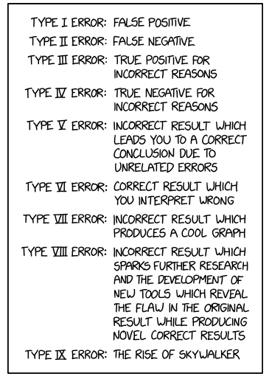
introduction
In science, there are errors that are committed
You could make a conclusion that there is a statistically significant difference or not
But are you correct?
How often do errors occur?
How can you avoid them?
https://m.xkcd.com/2303/

Slide 5
Motivating example
Suppose you are comparing the average age of two groups:
Group 1: 45 years
Group 2: 50 years
Difference in ages (Group 1 – Group 2): 5 years
Is this difference statistically different from 0?
P-value = 0.001
Answer: Yes, there is a statistically significant difference in average ages between Groups 1 and 2
But are you mistaken?

Slide 6
Let examine this problem (Type I error)
H0: difference in ages = 0
Ha: difference in ages is not 0
alpha (α ) = 0.05
Type I error = alpha
Type I error occurs when, among the sample, you reject the null hypothesis (or conclude that there is a statistically significant difference) when there is no true difference in the population (false positive)

Slide 7
How about Type II error?
H0: difference in ages = 0
Ha: difference in ages is not 0
beta (β ) = 0.20
Type II error = beta
Type II error occurs when, among the sample, you do not reject the null hypothesis (or conclude that there is no statistically significant difference) when there is a true difference in the population (false negative)

Slide 8
Type I and II errors at a glance
Results from sample | True difference in nature (population) | No true difference in nature (population)
Reject H0 | Correct | Type I error (False positive)
Fail to reject H0 | Type II error (False negative) | Correct

Slide 9
Power and specified effect size
Since beta (β ) is the probability of failing to reject the null when there is actually a true difference, then power (P) is the opposite
Power (1 - β ) is the ability to correctly reject the null hypothesis if the actual effect of the population is equal to or greater than the specified effect size
In other words, if you conclude that there is no difference in the sample, then there is no true difference in the population conditioned on the specified effect size
Effect size = What do you think the difference will be?
MCID = Minimal Clinically Important Difference
delta (δ ) usually denotes MCID

Slide 10
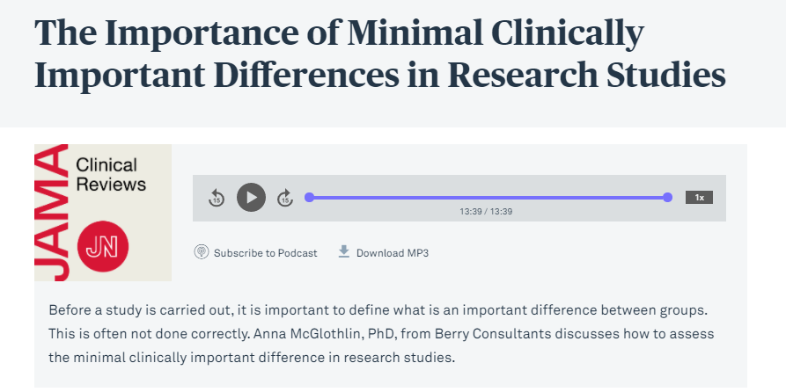
Determining MCID
“The MCID is a patient-centered concept, capturing both the magnitude of the improvement and also the value patients place on the change.”*
How do you determine MCID?
Experience
Literature
Expert opinions (e.g., Delphi method)
Patient Consensus
Best guess
Link to podcast
* McGlothlin AE, Lewis RJ. Minimal Clinically Important Difference: Defining What Really Matters to Patients. JAMA. 2014;312(13):1342–1343. doi:10.1001/jama.2014.13128

Slide 11
Sample Size
Sample size represents the number of subjects needed for a study
How many subjects are needed to test your hypothesis?
Depends on the effect size, level of significance, and power

Slide 12
Putting it together (1)
Alpha = Type I error
Beta = Type II error
Power = 1 – beta
MCID is the expected effect size
Beta
Power

Slide 13
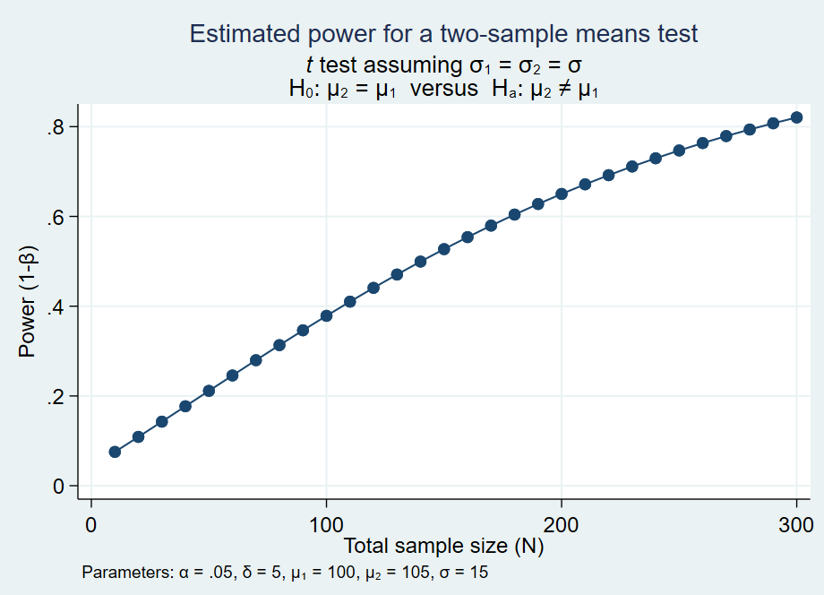
Putting it together (2)
Alpha = Type I error
Beta = Type II error
Power = 1 – beta
MCID is the expected effect size
Sample size
Power

Slide 14
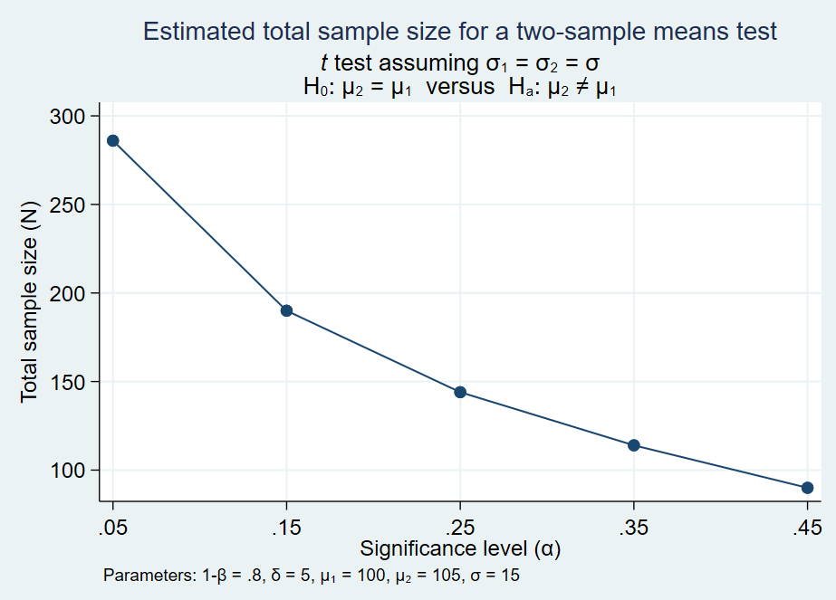
Putting it together (3)
Alpha = Type I error
Beta = Type II error
Power = 1 – beta
MCID is the expected effect size
Type I error
Sample Size

Slide 15
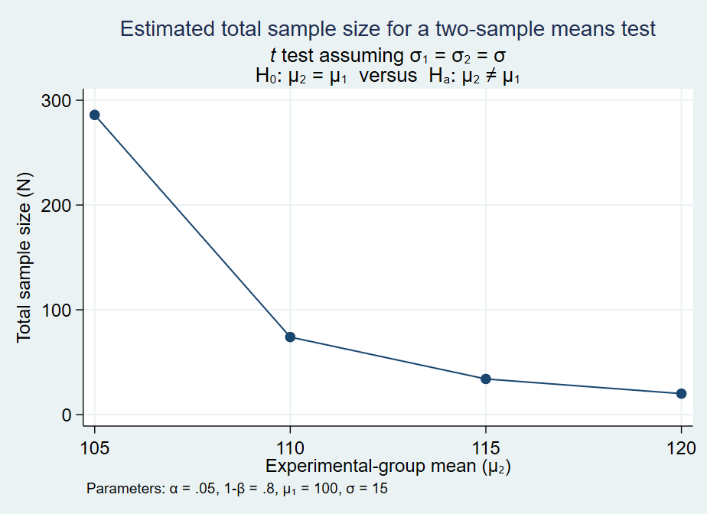
Putting it together (4)
Alpha = Type I error
Beta = Type II error
Power = 1 – beta
MCID is the expected effect size
Effect size
Sample Size

Slide 16


Estimating sample size for two independent means
Sample size formula for two independent means with a two-sided alpha of 0.05 and Power of 80%:
1.96
0.84
$$n_{i}=\frac{2∗{\left(Z_{\frac{α}{2}}+Z_{1−β}\right)}^{2}}{{\left(\frac{μ_{1}−μ_{2}}{σ}\right)}^{2}}$$
Difference in the means
Standard deviation of the population
$n_{i}$ is the sample size for one group
So for both groups with equal sample size, the total sample will be 2 * $n_{i}$

Slide 17


Estimating sample size for two proportions
Sample size formula for two independent proportions with a two-sided alpha of 0.05 and Power of 80%:
1.96
0.84
Proportion 1
Proportion 2
$$n_{i}=\frac{{\left(Z_{\frac{α}{2}}+Z_{1−β}\right)}^{2}+\left(p_{1}\left(1−p_{1}\right)\right)+\left(p_{2}\left(1−p_{2}\right)\right)}{{\left(p_{1}−p_{2}\right)}^{2}}$$
$n_{i}$ is the sample size for one group
So for both groups with equal sample size, the total sample will be 2 * $n_{i}$

Slide 18
Example (1)
Suppose you conducted an experiment comparing Drug A to Drug B
You want to measure the difference in Height (inches) after receiving each drug for 1 year
You make an educated guess that subjects receiving Drug A will have an average of 2 inches of growth and subjects receiving Drug B will have an average of 1.5 inches
You also make a guess that the population standard deviation is 0.5 inches
Based on these parameters, how many subjects will you need to enroll in your study?

Slide 19


Example (2)
Mean A = 2
Mean B = 1.5
SD = 0.5
Alpha = 0.05
Beta = 0.2
$$n_{i}=\frac{2∗{\left(Z_{\frac{α}{2}}+Z_{1−β}\right)}^{2}}{{\left(\frac{μ_{1}−μ_{2}}{σ}\right)}^{2}}$$
$$n_{i}=\frac{2∗{\left(1.96+0.84\right)}^{2}}{{\left(\frac{2−1.5}{0.5}\right)}^{2}}$$
You will need approximately 16 to 17 subjects in each group
Therefore, you have 80% power to detect a difference of 0.5 inches or greater with a sample size of 16 to 17 per group using a statistical significance level of 0.05

Slide 20
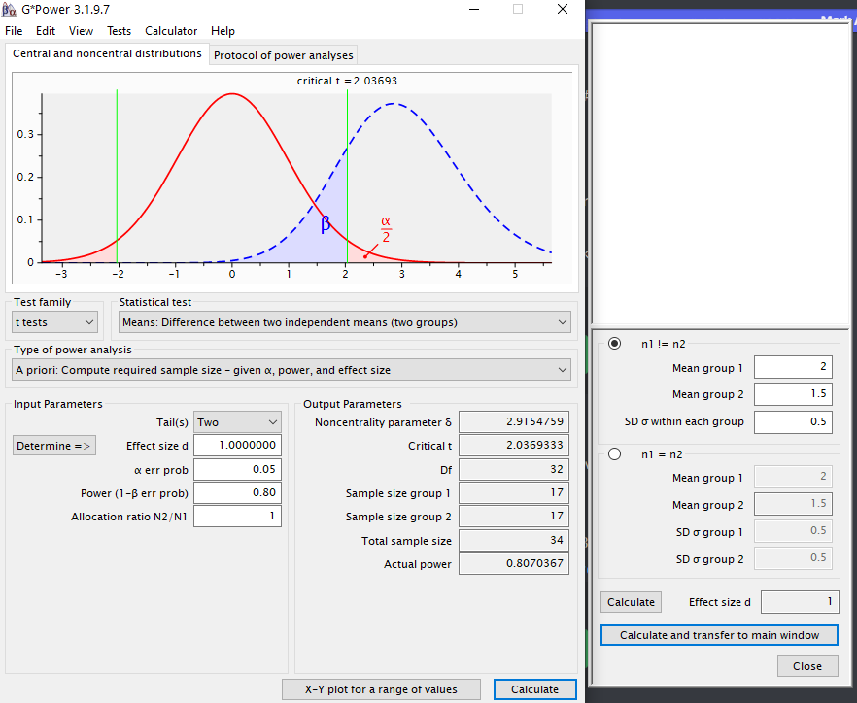
Example (2)
Mean A = 2
Mean B = 1.5
SD = 0.5
Alpha = 0.05
Beta = 0.2

Slide 21

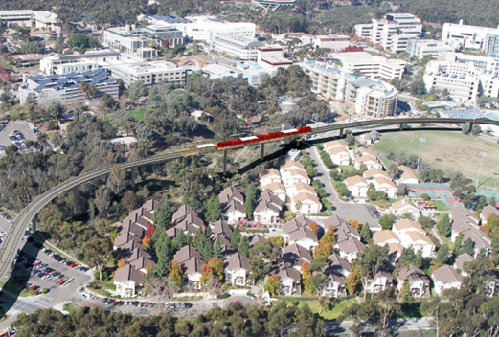
ADDITIONAL RESOURCES
UCLA Statistical Consulting – Power Analysis
Link to optional readings
JAMA Podcast on MCID
G*Power
G*Power tutorial (UCLA)
Sample Size Estimation R Tutorial

